Slide 1
Roy Lichtenstein
Year 10

Slide 2
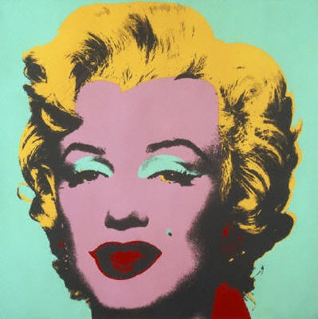
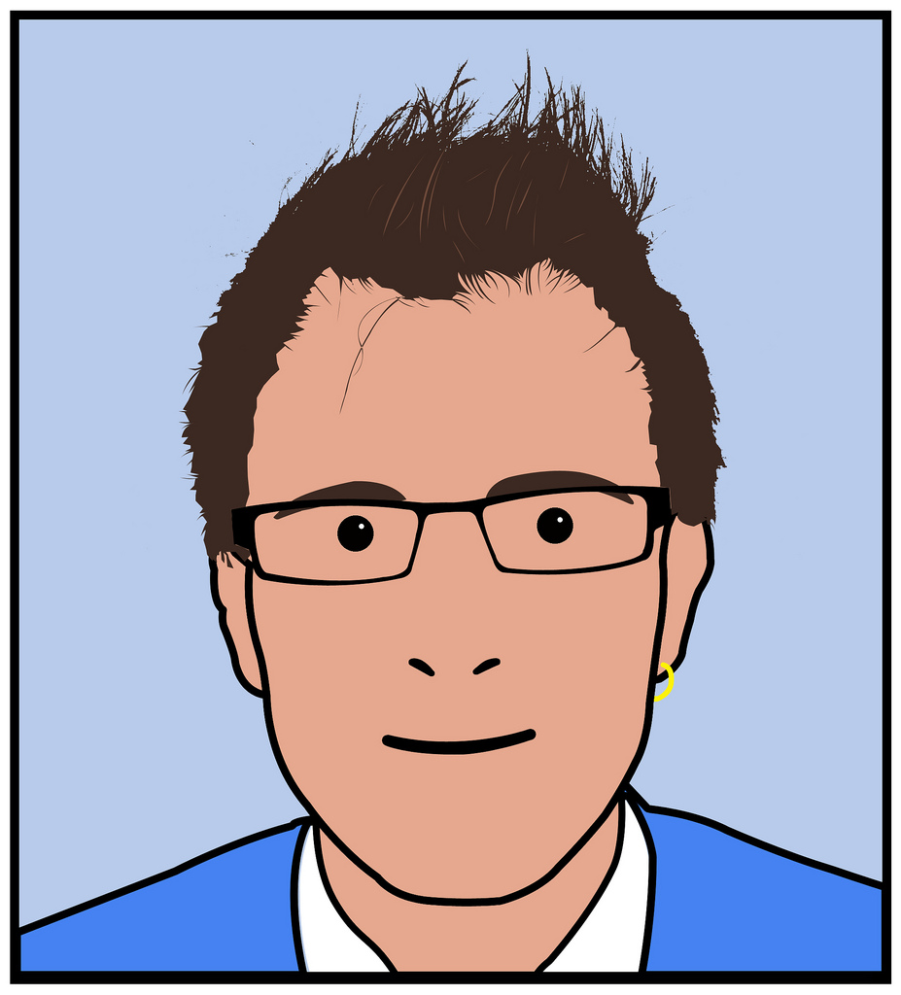
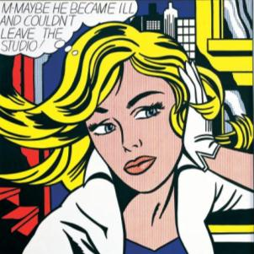
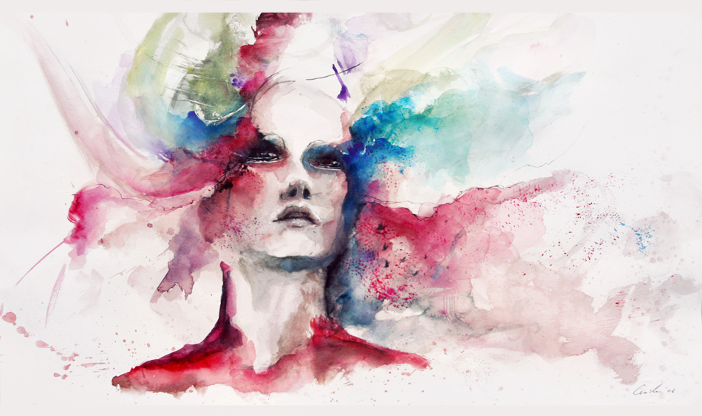
Starter – Which of these portraits are Pop Art? Why? What characteristics can you see?
Discuss in groups – how many of these images are Pop Art? Why do you think they are Pop Art?
1)
2)
3)
4)

Slide 3
Learning Objective
We are learning to…
Create a self portrait in the style of Roy Lichtenstein by recalling and including key characteristics of his work in our own work.

Slide 4
Success Criteria
All pupils will be able to recognise Roy Lichtenstein’s work and describe the key characteristics.
Most pupils will be able to create a self portrait demonstrating at least 3 key characteristics of Lichtenstein’s work in their own work.
Some pupils will be able to incorporate personal influences within their work.

Slide 5
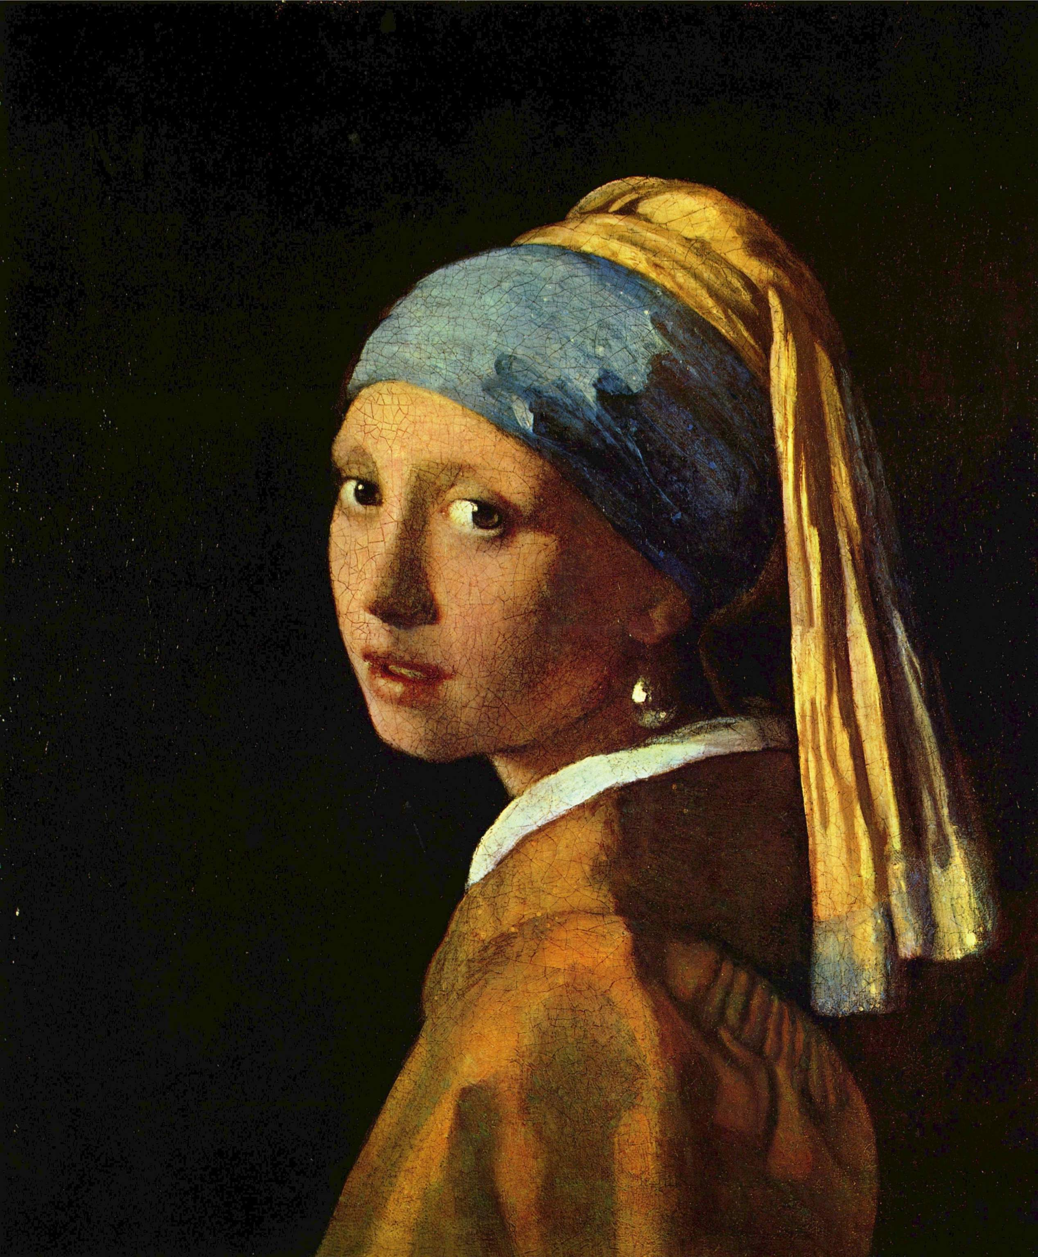
How could we recreate this famous portrait in the style of Roy Lichtenstein?
Discuss in groups
Girl with a the pearl earring - Johannes Vermeer

Slide 6
Planning your work
Plan your work –
Procedure
Materials
Techniques
Discuss in groups how you will carry out this work.

Slide 7
Evaluate
Look at your work and ask yourself….
Did I get the results I expected?
What could I have done differently?
Can I apply this way of thinking to other problems or situations? To create other artwork?
Is there anything I don’t understand—any gaps in my knowledge?

Slide 8

Plenary – Success Criteria
All pupils will be able to recognise Roy Lichtenstein’s work and describe the key characteristics.
Most pupils will be able to create a self portrait demonstrating at least 3 key characteristics of Lichtenstein’s work in their own work.
Some pupils will be able to incorporate personal influences within their work.

Slide 9
Acknowledgements
Ian Burt. Marilyn Monroe portrait, Flickr Creative Commons.
Trevor Coultart. Julian Opie portrait. Flickr Creative Commons.
Deviantart.com Creative Commons. Agnes-cecile.
Lichtensteins. Flab / Alamy Stock Photo
"Girl with a Pearl Earring", Wikimedia Creative Commons

